Slide 1

Department of Electronics & Communication
Engineering
PORTABLE SELF ASSESSMENT AUDIOMETER USING RASPBERRY PI
Batch No: B08
Domain: Embedded and IOT
Guided By: Mr.A.Shafeek M.E., AP(SS)/ECE
Review : 03
Presented By,
1. S.Naveen (727622BEC110)
2. S.Pranesh (727622BEC018)
3. M.Adhil (727622BEC114)

Slide 2
Contents
01. INTRODUCTION
02. PROBLEM STATEMENT
03. OBJECTIVES
04. ABSTRACT
05. LITERATURE SURVEY
06. REQUIREMENTS
07. BLOCK DIAGRAM
08. WORKING MODEL

Slide 3
Contents
09. WEEKLY PLAN WORK COMPLETED FOR
FIRST & SECONDREVIEW
10. VALIDATION AND FEEDBACK: MEETING
WITH AUDIOLOGIST IN POLLACHI
11. RESULT
12. WORK TO BE COMPLETED
13. CONCLUSION
14. REFERENCES

Slide 4
Introduction
Hearing loss is a common problem, especially for older adults.
It can make it hard to hear and talk to others.
Current hearing tests need a doctor and special rooms, which can be expensive and inconvenient.
This project created a portable hearing test anyone can use at home.
This could help people find out about hearing loss earlier and easier.

Slide 5
Problem Statement
The project aims to develop a portable audiometer for hearing self-assessment, addressing the limitations of conventional audiometers.
This cost-effective and user-friendly solution improves access to early detection and treatment of hearing loss, benefiting hearing-impaired individuals.

Slide 6
Objectives
Develop a portable audiometer for self-assessment.
Automate the hearing test process for efficiency.
Create a user-friendly interface using Python.
Generate accurate audiograms and store data effectively.
Notes:
e

Slide 7
Abstract
This study introduces a portable audiometer for self-assessment of hearing impairment, leveraging Raspberry Pi and Python. Users receive sound signals via headphones, responding with a patient button.
An automatic audiogram aids assessment, with results digitally stored. A familiarization process ensures user understanding, and the Hughson Westlake procedure enhances efficiency.

Slide 8
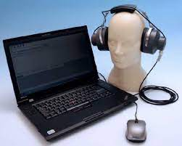
Abstract
Leveraging open-source Python minimizes software development costs. This innovative approach offers accessible and cost-effective hearing screening for elderly and hearing-impaired individuals.

Slide 9
Literature survey
Sl. No | Authors | Title of the paper | Journal | Year | Key points
1 | Ritu Rani; H.T. Patil | Portable audiometer for detecting hearing disorder at an early stage for cancer patient | IEEE | 2016 | Early detection, hearing loss,
2 | Marwa Gargouri; Mondher Chaoui; Patrice Wira | Development of hearing self-assessment pure tone audiometer | IEEE | 2020 | Self-test, hearing check, tones

Slide 10
Literature Survey
Sl. No | Authors | Title of the paper | Journal | Year | Key points
3 | M.Dharani kumar Chowdhary | A novel raspberry pi-3 based pure tone audiometer and verification of calibration with standard system | Journal of Data Acquisition and Processing | 2020 | Calibration, Raspberry Pi
4 | Silvia Figueira; Kevin Nguyen | HearThat? - An app for diagnosing hearing loss | IEEE | 2019 | Home test, Hearing check, App

Slide 11
Requirements
Raspberry Pi 3 B+
Mouse
Headphone
Raspberry pi OS & Python
Raspberry pi Case
HDMI to HDMI Cable
Ethernet Cable
USB Cable

Slide 12
Block diagram

Slide 13
Working Model
Components: Raspberry Pi 3 B+, computer, patient response button, and headphones.
Sound Signal Delivery: Headphones deliver sound signals of varying frequencies and volumes.
Patient Response:Patients respond using a mouse button, providing feedback for recording.
Data Processing: Real-time processing captures frequency, volume, and reaction time data.
Output: Generates audiograms and visualizations for easy interpretation of hearing levels.

Slide 14
Work Plan
Week Task | Week_1 (06.02.24 to 12.02.24) | Week_2 (16.2.24 to 23.2.24) | Week_3 (27.02.24 to 04.03.24) | Week_4 (05.03.24 to 12.03.24) | Week_5 (14.03.24 to 29.03.24) | Week_6 (30.3.24 to till now) | Status
Topic analysis |  |  |  |  |  |  | Completed
Objective& Abstract |  |  |  |  |  |  | Completed
Components Analysis |  |  |  |  |  |  | Completed
Design & Software installing |  |  |  |  |  |  | Completed
Learning Python |  |  |  |  |  |  | Completed
Coding & Result |  |  |  |  |  |  | Completed
Project completion |  |  |  |  |  |  | Completed

Slide 15
Work Completed for First review
Week Task | Week_1 (06.2.2024 To 12.2.2024) | Week_2 (16.2.2024 To 23.2.2024) | Week_3 (27.02.2024 To 04.03.2024) | Status
Topic Analysis |  |  |  | Completed
We have learnt about the project |  |  |  | Completed
PPT preparation |  |  |  | Completed
Parts procurement |  |  |  | Completed

Slide 16
Work Completed for Second review
Week Task | Week_4 (05.032024 To 12.03.2024) | Week_5 (12.03.2024 TO 29.03.2024) | Week_6 30.03.2024 To Till now) | Status
Components purchased |  |  |  | Completed
Installing Raspbian OS |  |  |  | Completed
Coding & Output |  |  |  | Completed
Result |  |  |  | Completed

Slide 17
Work Completed for Third review
Week Task | Week_4 (01.04.2024 To 06.04.2024) | Week_5 (08.04.2024 TO 15.04.2024) | Week_6 22.04.2024 To Till now) | Status
Debugging the Code |  |  |  | Completed
Analysis the Audiogram Chat |  |  |  | Completed
Visited ENT Doctor |  |  |  | Completed
Report Preparatin & Doctor Suggestion |  |  |  | Completed
Consulting with an Audiologist |  |  |  | In- progress

Slide 18
Validation and Feedback: Meeting with Audiologist in Pollachi
After completing my project on the pure tone audiometer and thoroughly studying audiogram charts, I had the opportunity to meet with Dr. B. Harsha Vardhan, an ENT specialist in Mahalingapuram, Pollachi. During our 30-minute discussion, Dr. Vardhan praised the project, expressing interest in purchasing the self-assessment pure tone audiometer I had developed.

Slide 19
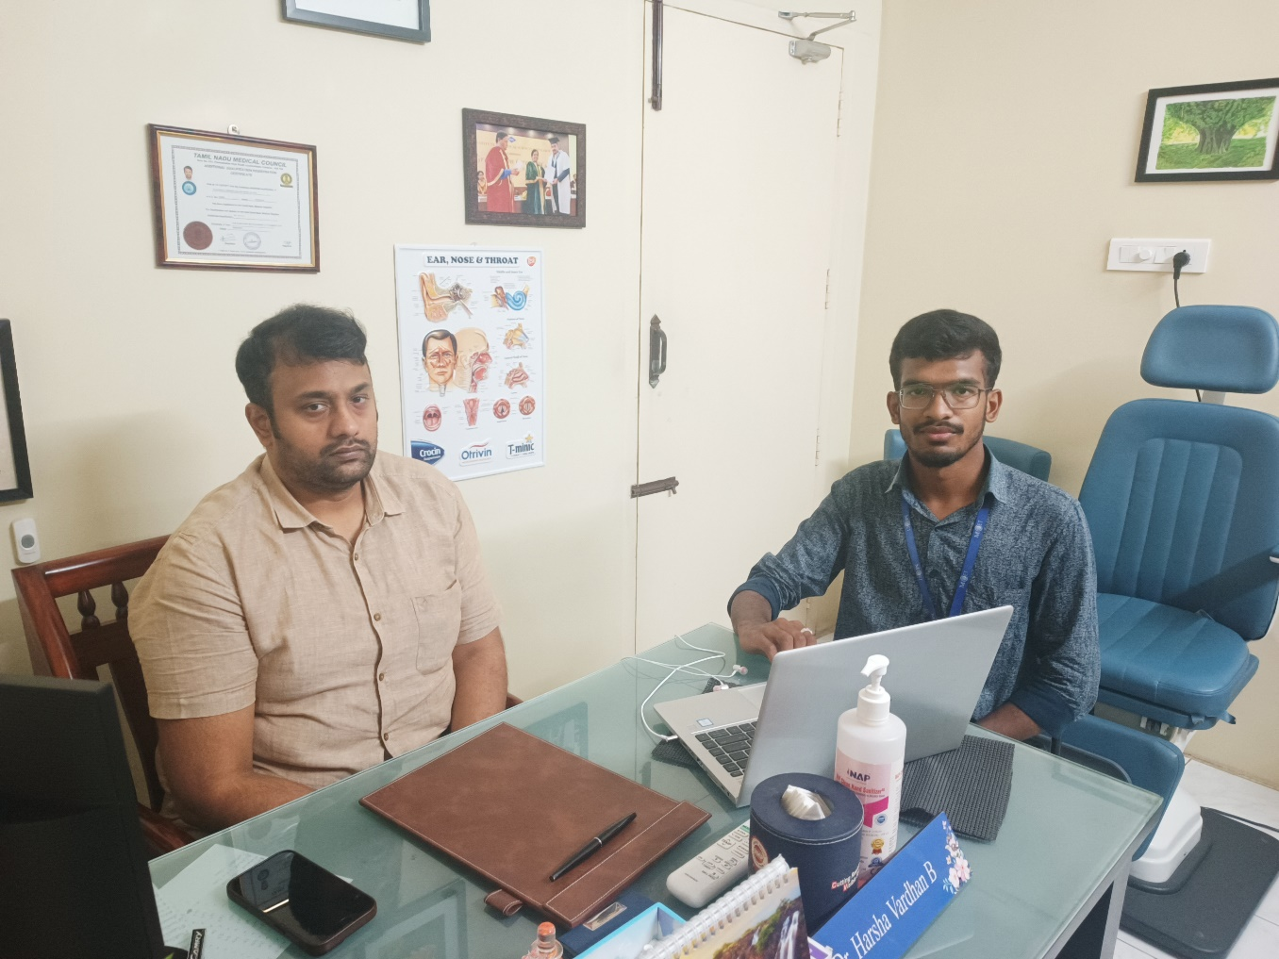
Validation and Feedback: Meeting with Audiologist in Pollachi

Slide 20
Validation and Feedback: Meeting with Audiologist in Pollachi
He suggested that I meet with an audiologist in Pollachi to further validate my device. Dr. Vardhan provided me with the audiologist's contact information, mentioning that their original pure tone audiometer costs around 1.50 lakhs. He emphasized the importance of testing my self-assessment audiometer with deaf individuals to analyze its accuracy.

Slide 21
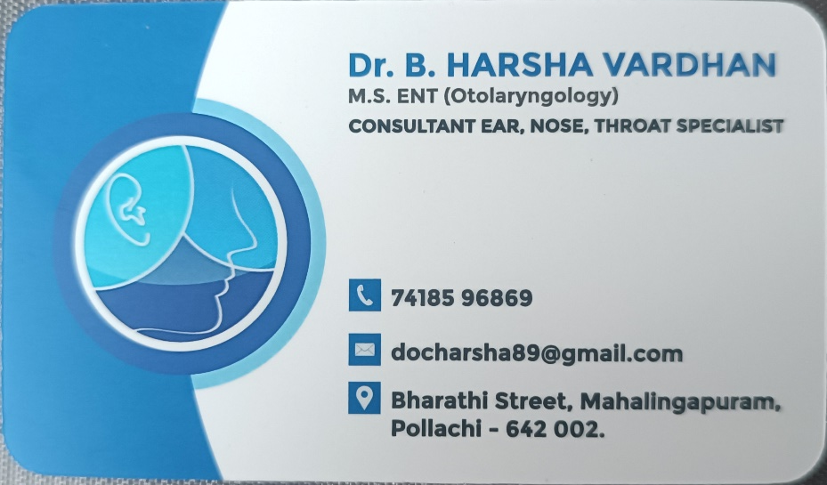
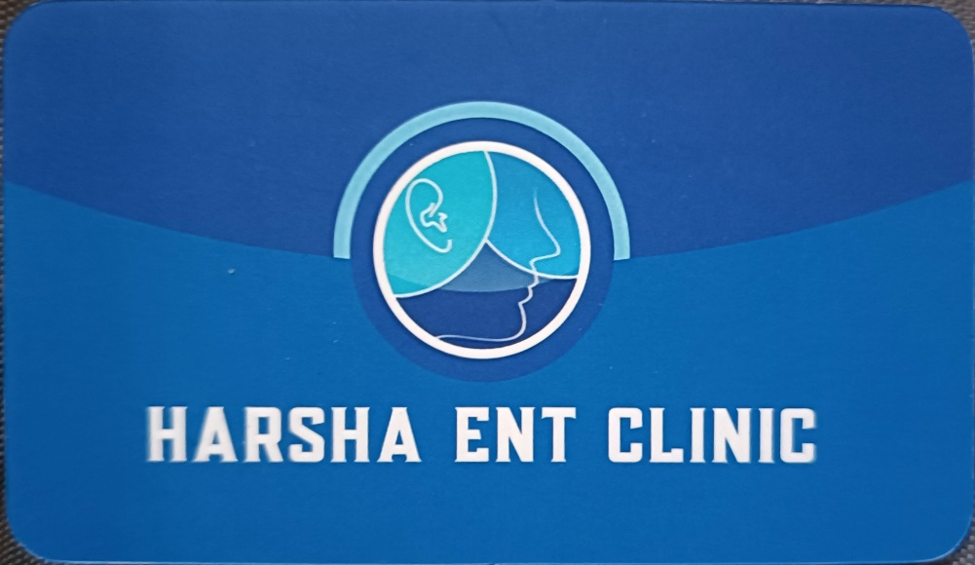
Validation and Feedback: Meeting with Audiologist in Pollachi
Upon meeting the audiologist, I learned that minor adjustments were needed in the output of the audiogram, specifically regarding the x and y-axis. Despite this, the audiologist commended the project's concept and efficacy.

Slide 22
Validation and Feedback: Meeting with Audiologist in Pollachi
During testing, it became apparent that while my self-assessment audiometer produced satisfactory results, there were variations in tone compared to actual pure tone audiometers. Dr. Vardhan reiterated the importance of refining the device to accurately replicate the varied tones experienced by individuals during hearing assessments

Slide 23
Results
The developed portable audiometer successfully allows for self-assessment of hearing impairment. Utilizing a Raspberry Pi 3 B+, headphones, and patient response button, it facilitates efficient testing. The system produces an automatic audiogram based on patient responses, saving data in CSV files for analysis.

Slide 24
Results
After consulting an ENT doctor and audiologist, minor adjustments were made to improve accuracy. Testing with both professionals and hearing-impaired individuals yielded promising results. While the audiometer's output differed slightly from conventional devices, it effectively detected hearing impairments. The cost-effective Python programming language facilitated software development, enhancing accessibility.

Slide 25
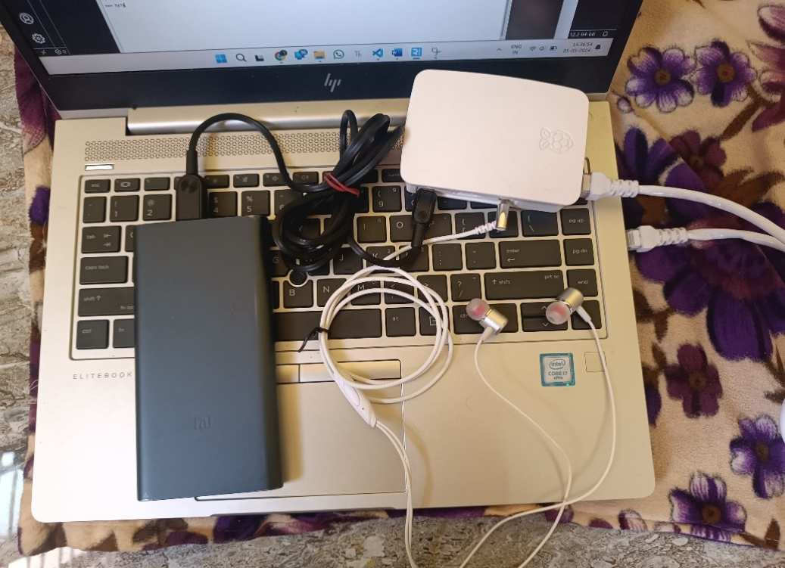
Results
Overall Initialization Pure Tone Audiometer

Slide 26
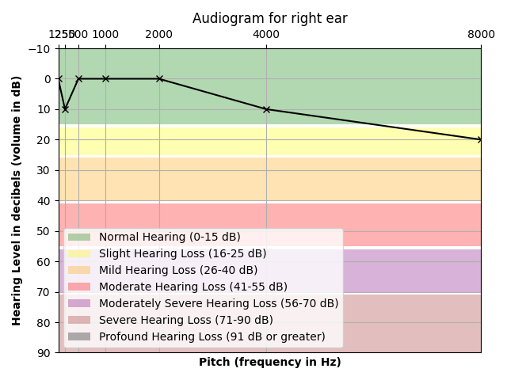
Results
AUDIOGRAM CHART

Slide 27
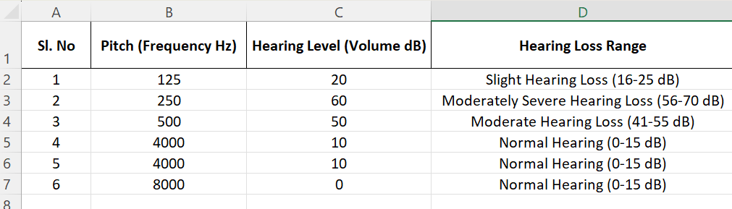
Results
RESULT ANALYSIS

Slide 28
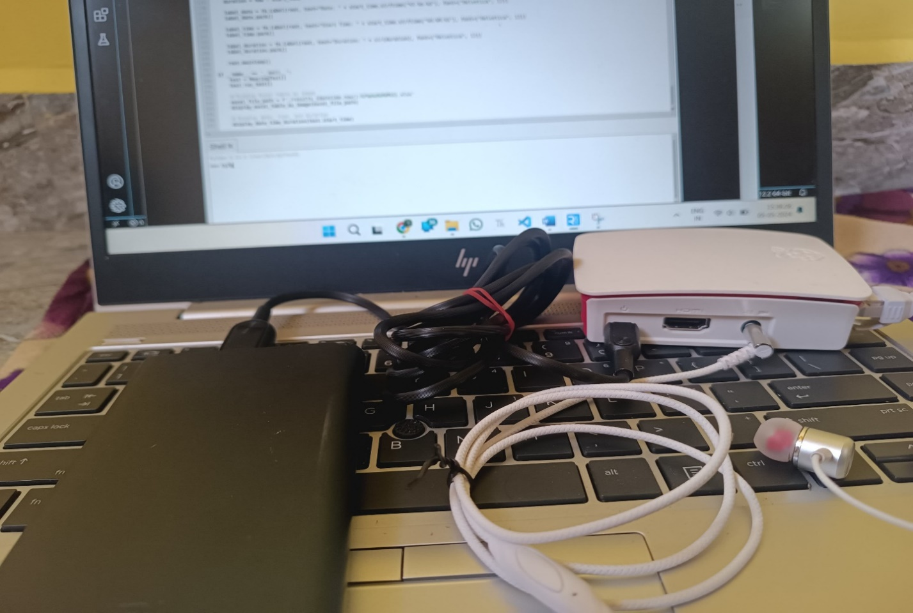
Results
PORTABLE SELF ASSESSMENT AUDIOMETER

Slide 29
Work to be completed
Week Task | Week_4 (01.04.2024 To 06.04.2024) | Week_5 (08.04.2024 TO 15.04.2024) | Week_6 16.04.2024 To 27.04.24) | Week_4 (01.05.2024 To 06.05.2024) | Status
Consulting with an Audiologist |  |  |  |  | In progress

Slide 30
Conclusion
The portable audiometer is a cost-effective solution for self-assessing hearing impairment, saving time and money compared to traditional methods. Developed in collaboration with medical professionals, it is accurate and reliable, despite minor differences in sound quality.

Slide 31
Conclusion
Future improvements could focus on refining the device's sound output. This project highlights the potential for affordable healthcare technologies that empower individuals to manage their health effectively.

Slide 32
References
”Ritu Rani; H.T. Patil”, “Portable audiometer for detecting hearing disorder at an early stage for cancer patient”, “2016 International Conference on Automatic Control and Dynamic Optimization Techniques”.
“Marwa Gargouri;, Mondher Chaoui” ,“Development of hearing self-assessment pure tone audiometer, “2020 IEEE International Conference on Design & Test of Integrated Micro & Nano-Systems (DTS)”

Slide 33
References
“M.Dharani kumar Chowdhary, Dr. C. Nagaraja ”,” A novel raspberry pi-3 based pure tone audiometer and verification of calibration with standard system, “Journal of Data Acquisition and Processing(2020)”.
“Silvia Figueira; Kevin Nguyen; Shweta Panditrao”,
“HearThat? - An app for diagnosing hearing loss”, “IEEE Global Humanitarian Technology Conference (GHTC 2019)”.

Slide 34


